Slide 1
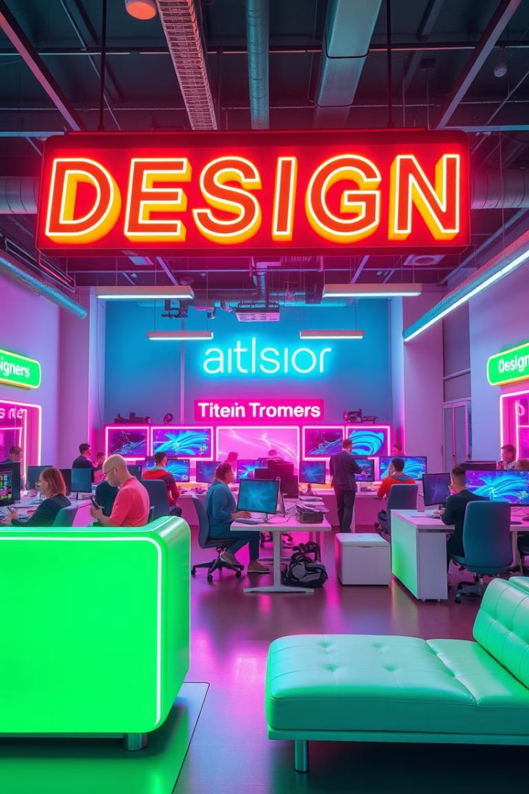

Artificial Intelligence in Design
This presentation explores the transformative impact of Artificial Intelligence (AI) in the realm of design, highlighting its potential to enhance creativity, efficiency, and user experience.
by ShaTech jsjk

Slide 2
The Rise of Generative AI in Design
Revolutionizing Creativity
Accelerating Design Processes
Generative AI empowers designers to explore a wider range of possibilities by generating novel designs based on user inputs, constraints, and preferences.
AI tools automate repetitive tasks, freeing up designers to focus on higher-level design decisions, conceptualization, and strategic thinking.

Slide 3



Optimizing Physical Object Design with AI
Enhanced Functionality
AI-powered design tools can optimize object performance by analyzing structural integrity, material usage, and ergonomic factors.
1
Improved Manufacturing Processes
2
AI can generate optimized manufacturing instructions, minimizing waste, reducing production costs, and enhancing efficiency.
Personalized Design Experiences
3
AI enables the creation of personalized products tailored to individual user needs and preferences, fostering greater customer satisfaction.

Slide 4

Combating Hallucination in Generative AI
Data Quality
Model Validation
Ensuring high-quality and diverse training data is crucial for mitigating hallucination, providing AI with accurate information to learn from.
Rigorous model validation and testing processes are essential to identify and address biases and errors in generated outputs.
Human Oversight
Human designers should remain involved in the process, providing feedback, refining outputs, and ensuring the generated results align with design principles.

Slide 5
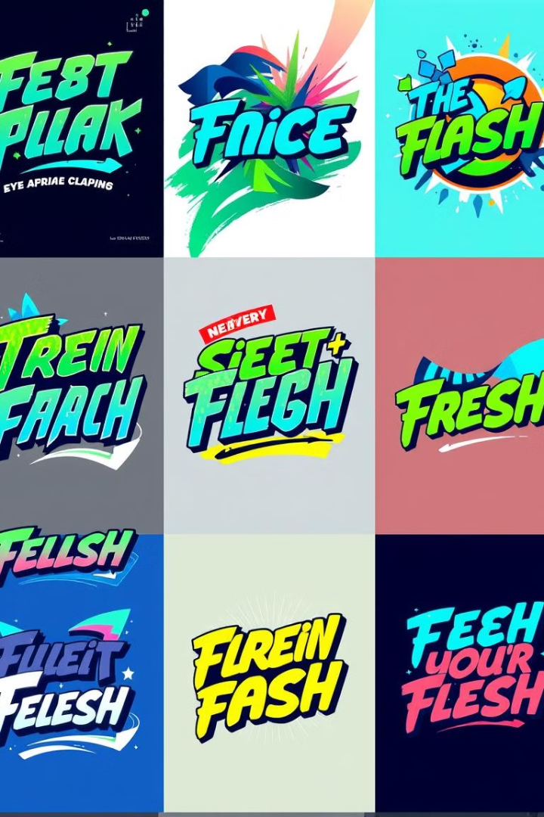



Generative AI in Graphic Design
Logo Creation
Color Palette Generation
AI algorithms can generate unique and memorable logo designs based on brand guidelines and visual preferences.
AI tools can suggest harmonious color palettes that enhance visual appeal and evoke desired emotions.
Typographic Experimentation
AI can assist in exploring various font styles, sizes, and arrangements to create visually compelling typography.

Slide 6
Transforming Architecture and Urban Planning
Sustainable Design
1
AI can optimize building design for energy efficiency, resource conservation, and environmental sustainability.
Adaptive Planning
2
AI-powered tools can analyze urban data to identify areas for improvement, optimize infrastructure, and create more resilient and adaptable cities.
Collaborative Design
3
AI platforms enable collaborative design processes, facilitating communication and integration among architects, engineers, and stakeholders.

Slide 7

AI-Powered Fashion Design
1
2
3
Trend Forecasting
Personalized Design
Sustainable Production
AI analyzes vast amounts of data to identify emerging trends and predict future fashion styles.
AI algorithms can create custom garment designs tailored to individual body measurements and style preferences.
AI optimizes fabric usage, reduces waste, and promotes eco-friendly manufacturing practices.

Slide 8

The Role of Cloud-based Generative AI
1
Scalability
2
Accessibility
Cloud-based AI allows designers to access powerful computing resources on demand, scaling their projects as needed.
Cloud platforms democratize AI technology, making it accessible to a wider range of designers and businesses.
3
Collaboration
Cloud-based AI facilitates collaborative design workflows, enabling teams to work together remotely and share resources.

Slide 9




Balancing Automation and Human Creativity
Augmenting Human Abilities
AI acts as a powerful tool, enhancing human creativity by providing inspiration, generating ideas, and automating tedious tasks.
Preserving Human Expertise
Human designers play a crucial role in shaping AI-generated outputs, ensuring aesthetic appeal, conceptual integrity, and emotional resonance.
Promoting Ethical Design
Human oversight is essential to prevent AI from generating biased or harmful designs, promoting responsible and inclusive design practices.

Slide 10
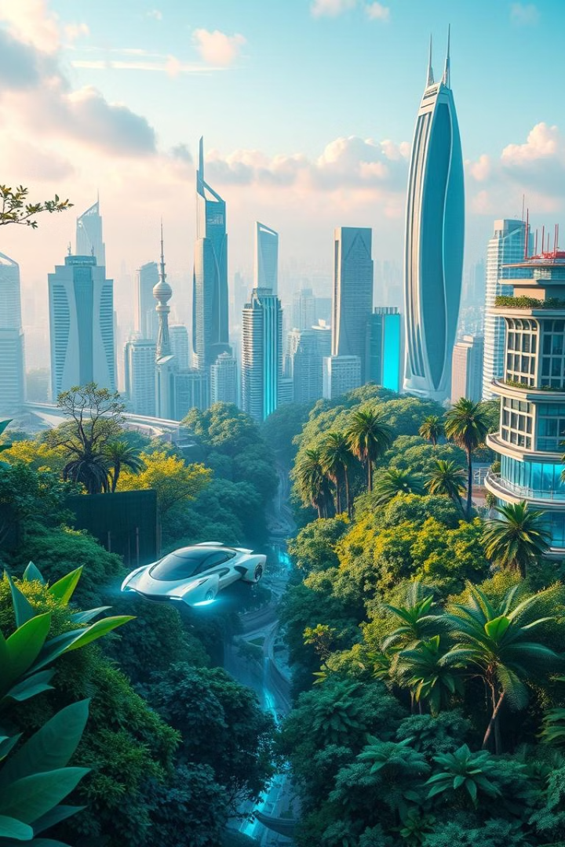
The Future of Generative Design
Generative design is poised to revolutionize the design landscape, pushing the boundaries of creativity and efficiency. As AI technology continues to evolve, we can expect to see increasingly sophisticated tools that empower designers to explore new frontiers of design innovation.

